Slide 1


Algorithms Design and Analysis
算法设计与分析
山东大学软件学院 2023

Slide 2
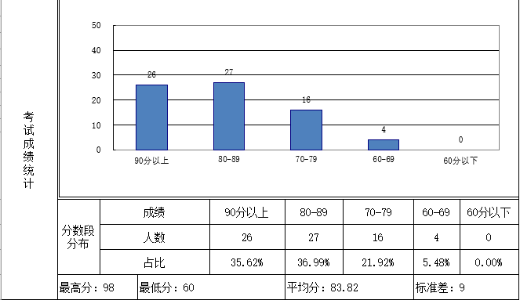
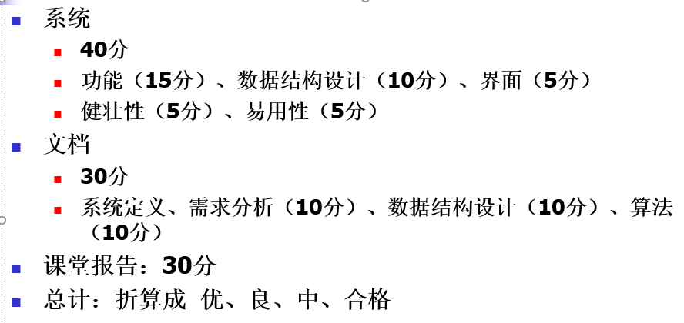
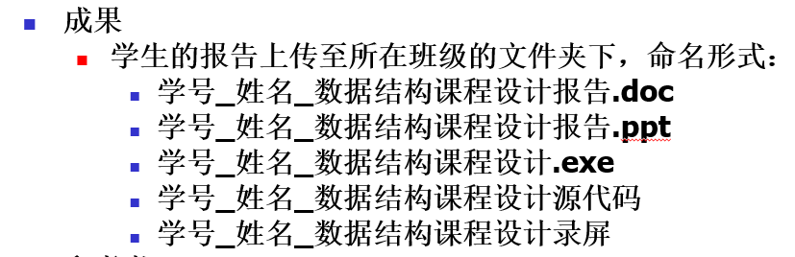

Slide 3
Required Textbook—教材:
Cormen, Leiserson, Rivest, Stein, Introduction to Algorithms,
McGraw Hill/MIT Press
Bible! MIT
3rd edition
References—参考书:
M.H. Alsuwaiyel , Algorithm Design Techniques and Analysis, 2003
电子工业出版社
Kleinberg and Tardos, Algorithm Design, Addison Wesley, 2006
Cornell
Dasgupta, Papadimitriou, and Vazirani, Algorithms, McGraw-Hill, 2007
UC Berkeley
Steven S. Skiena, The Algorithm Design Manual, 2nd Ed., Springer, 2008
Open courses & MOOC:
麻省理工学院公开课：算法导论, https://open.163.com/newview/movie/courseintro?newurl=M6UTT5U0I
其它大学的慕课资源，算法设计与分析等课程

Slide 4
Course Objectives
Study unifying principles and concepts of algorithm design
Algorithmic problems form the heart of computer science
Polish our critical thinking and problem-solving technique
Algorithmic problems tend to come bundled together with lots of messy, application-specific detail, some of it essential, some of it extraneous
Two fundamental components
Get to the mathematically clean core of a problem
Identify the appropriate algorithm design techniques based on the structure of the problem

Slide 5
Course Prerequisites and Skeleton
Data structures
Discrete mathematics
Computer programming in C, C++, Java, Python, etc.
Design
Analysis
Divide
&
Conquer
Greedy
Dynamic
Programming
…
B
a
s
i
c
s
C
a
s
e
s
M
S
Q
S
…
A
S
P
H
u
f
f
m
a
n
…
A
L
S
M
C
M
…
H
S
…

Slide 6
Course Outline
第1章 算法的基本概念
（算法导论第1、2、3章，选讲部分内容）
1.1 问题、算法的基本概念，算法和问题的关系。
1.2 对算法的衡量，时间复杂性，空间复杂性（算法的复杂性）。
1.3 函数的增长，渐进符号O，Ω，Θ。了解渐近符号o和ω。
1.4* 计算复杂性非常简单的、导入性的介绍（问题的复杂性）。
第2章 分治法
（算法导论第2.3节（归并排序），第4章）
2.1 分治法的基本思想，归并排序。
2.2 最大子数组问题；
2.3* 斯特拉斯矩阵乘法。
第3章 动态规划
（算法导论第15章）
3.1 通过钢条切割、矩阵链乘法的例子，引入动态规划的设计方法。
3.2 动态规划原理，最优子结构性质，子问题重叠性质，设计和分析动态规划算法；
3.3 最长公共子序列问题。
第4章 贪心法
（算法导论第16章）
4.1 通过活动选择问题引入贪心算法。
4.2 贪心算法原理，设计和分析贪心算法。
4.3 Dijkstra的最短路算法。
第5章 最短路问题
（算法导论第第24、25章）
5.1 Bellman-Ford算法。
5.2 基于边数分解的动态规划算法（第25.1节）。
5.3 基于顶点编号分解的动态规划算法（第25.2节，Floyd-Warshall算法）。
第6章 最大流问题
（算法导论第26章）
6.1 流网络的基本概念
6.2 Ford-Fulkerson算法（最大流的增广路算法）
6.3 最大匹配问题（使用最大流解二分图上的最大匹配）
第7章 NP完全性
（算法导论第34章）
7.1 P和NP的基本概念（多项式时间可解和多项式时间可验证）。
*了解P =? NP的涵义。
7.2 归约和NP完全性
*提及性地简要介绍Cook-Levin定理（SAT问题是NP完全的），其证明过程不需要掌握。
7.3 NP完全问题举例（团问题、顶点覆盖问题、子集和问题）
*提及性地简要介绍哈密尔顿回路问题的NP完全性证明。
第8章 近似算法初步
（算法导论第35章）
8.1* 顶点覆盖问题的近似算法。
8.2 度量TSP问题的近似算法和一般TSP问题的不可近似性。

Slide 7
Chapter 1. The Role of Algorithms in Computing
What are algorithms?
Why is the study of algorithms worthwhile?
What is the role of algorithms relative to other technologies used in computers?
outline
Basic Concepts:
An algorithm is any well-defined computational procedure that takes some value, or set of values, as input and produces some value, or set of values, as output
A computational problem specifies in general terms the desired input/output relationship.
An instance of a problem consists of the input needed to compute a solution to the problem.
An algorithm is said to be correct if, for every input instance, it halts with the correct output. We say that a correct algorithm solves the given computational problem.
Input
Algorithm
Output

Slide 8
The Role of Algorithms in Computing
Data structures
A data structure is a way to store and organize data in order to facilitate access and modifications.
Hard problems——NP-complete problems
First, no one knows whether or not efficient algorithms exist for NP-complete problems.
Second, if an efficient algorithm exists for any one of them, then efficient algorithms exist for all of them.
Third, several NP-complete problems are similar, but not identical, to problems for which we do know of efficient algorithms.
Efficiency of algorithm
Time complexity
Space complexity

Slide 9
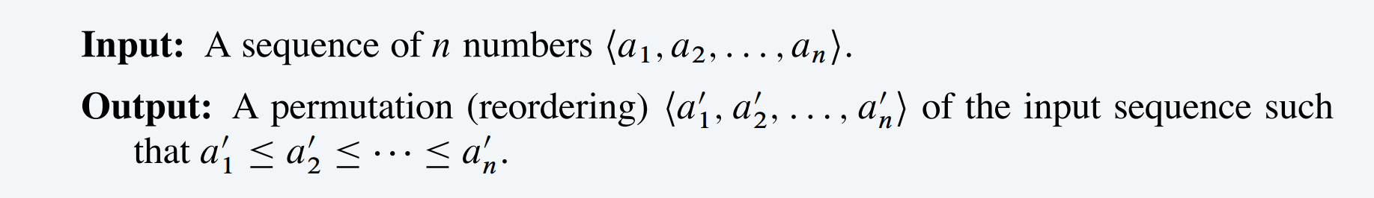
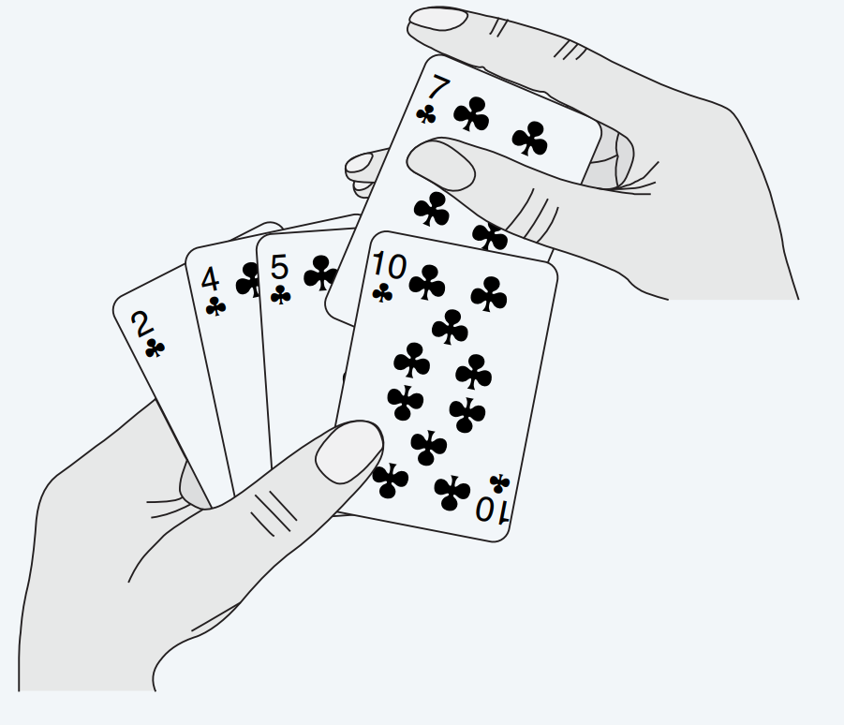
Chapter 2 Getting Started —— An example
Problem formalization
Algorithm (pseudo-code, design)
Analysis
Sorting Problem:

Slide 10
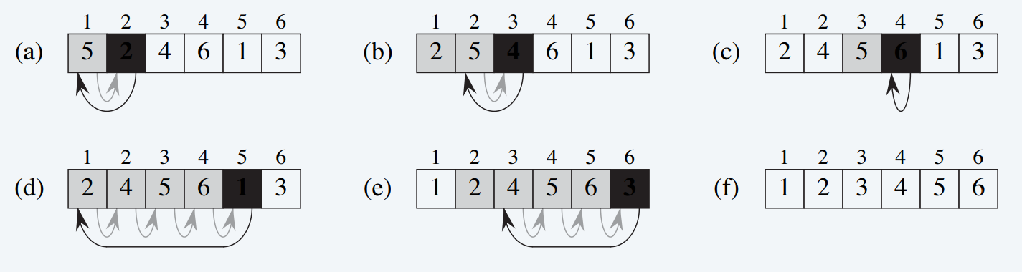
Framework
Problem formalization
Algorithm (pseudo-code, design)
Analysis
Sorting Problem:
2
4
6
1
3

Slide 11
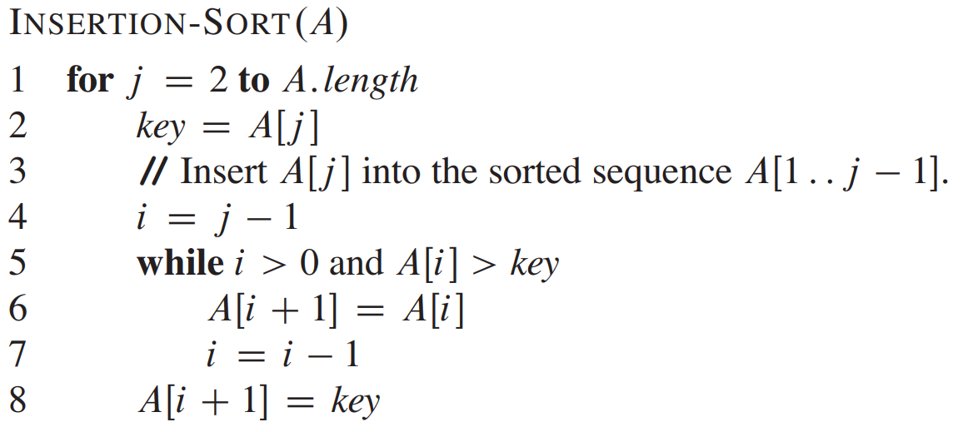
Framework
Problem formalization
Algorithm (pseudo-code, design)
Analysis
Sorting Problem:

Slide 12
Framework
Problem formalization
Algorithm (pseudo-code, design)
Analysis
Correctness (too simple, so omitted here)
Efficiency
Sorting Problem:

Slide 13
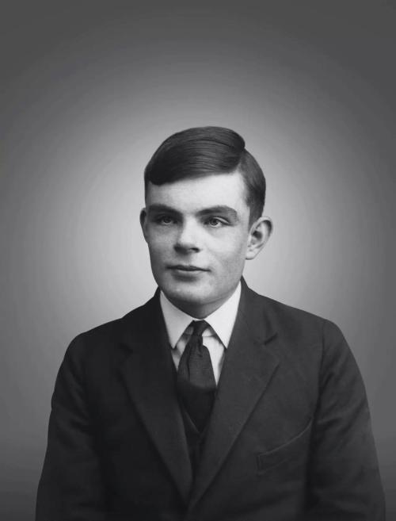

Efficiency: Models of computation -- Turing machines
Deterministic Turing machine (DTM). Simple and idealistic model.

Slide 14
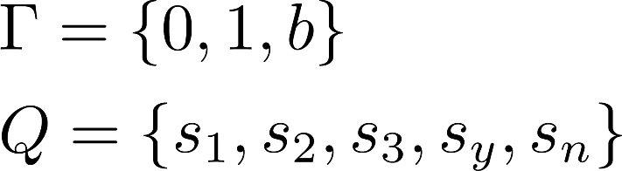
Efficiency: Turing machines demo 1
Task. Determine the parity of an integer
Machine configuration:
 | 0 | 1 | b
s₁ | (s₁, 0, R) | (s₁, 1, R) | (s₂, b, L)
s₂ | (s₃, 0, N) | (s₃, 1, N) | (s₃,b, N)
s₃ | (s_{y}, 0, N) | (s_{n}, 1, N) | (s₃, b, N)

Slide 15
Turing machines demo 1
 | 0 | 1 | b
s₁ | (s₁, 0, R) | (s₁, 1, R) | (s₂, b, L)
s₂ | (s₃, 0, N) | (s₃, 1, N) | (s₃, b, N)
s₃ | (s_{y}, 0, N) | (s_{n}, 1, N) | (s₃, b, N)
… | b | b | 1 | 0 | 1 | 0 | b | b | b | b | …
… | -1 | 0 | 1 | 2 | 3 | 4 | 5 | 6 | 7 | 8 | …
s₁

Slide 16
Turing machines demo 1
 | 0 | 1 | b
s₁ | (s₁, 0, R) | (s₁, 1, R) | (s₂, b, L)
s₂ | (s₃, 0, N) | (s₃, 1, N) | (s₃, b, N)
s₃ | (s_{y}, 0, N) | (s_{n}, 1, N) | (s₃, b, N)
… | b | b | 1 | 0 | 1 | 0 | b | b | b | b | …
… | -1 | 0 | 1 | 2 | 3 | 4 | 5 | 6 | 7 | 8 | …
s₁

Slide 17
Turing machines demo 1
 | 0 | 1 | b
s₁ | (s₁, 0, R) | (s₁, 1, R) | (s₂, b, L)
s₂ | (s₃, 0, N) | (s₃, 1, N) | (s₃, b, N)
s₃ | (s_{y}, 0, N) | (s_{n}, 1, N) | (s₃, b, N)
… | b | b | 1 | 0 | 1 | 0 | b | b | b | b | …
… | -1 | 0 | 1 | 2 | 3 | 4 | 5 | 6 | 7 | 8 | …
s₁

Slide 18
Turing machines demo 1
 | 0 | 1 | b
s₁ | (s₁, 0, R) | (s₁, 1, R) | (s₂, b, L)
s₂ | (s₃, 0, N) | (s₃, 1, N) | (s₃, b, N)
s₃ | (s_{y}, 0, N) | (s_{n}, 1, N) | (s₃, b, N)
… | b | b | 1 | 0 | 1 | 0 | b | b | b | b | …
… | -1 | 0 | 1 | 2 | 3 | 4 | 5 | 6 | 7 | 8 | …
s₁

Slide 19
Turing machines demo 1
 | 0 | 1 | b
s₁ | (s₁, 0, R) | (s₁, 1, R) | (s₂, b, L)
s₂ | (s₃, 0, N) | (s₃, 1, N) | (s₃, b, N)
s₃ | (s_{y}, 0, N) | (s_{n}, 1, N) | (s₃, b, N)
… | b | b | 1 | 0 | 1 | 0 | b | b | b | b | …
… | -1 | 0 | 1 | 2 | 3 | 4 | 5 | 6 | 7 | 8 | …
s₁

Slide 20
Turing machines demo 1
 | 0 | 1 | b
s₁ | (s₁, 0, R) | (s₁, 1, R) | (s₂, b, L)
s₂ | (s₃, 0, N) | (s₃, 1, N) | (s₃, b, N)
s₃ | (s_{y}, 0, N) | (s_{n}, 1, N) | (s₃, b, N)
… | b | b | 1 | 0 | 1 | 0 | b | b | b | b | …
… | -1 | 0 | 1 | 2 | 3 | 4 | 5 | 6 | 7 | 8 | …
s₂

Slide 21
Turing machines demo 1
 | 0 | 1 | b
s₁ | (s₁, 0, R) | (s₁, 1, R) | (s₂, b, L)
s₂ | (s₃, 0, N) | (s₃, 1, N) | (s₃, b, N)
s₃ | (s_{y}, 0, N) | (s_{n}, 1, N) | (s₃, b, N)
… | b | b | 1 | 0 | 1 | 0 | b | b | b | b | …
… | -1 | 0 | 1 | 2 | 3 | 4 | 5 | 6 | 7 | 8 | …
s₃

Slide 22
Turing machines demo 1
 | 0 | 1 | b
s₁ | (s₁, 0, R) | (s₁, 1, R) | (s₂, b, L)
s₂ | (s₃, 0, N) | (s₃, 1, N) | (s₃, b, N)
s₃ | (s_{y}, 0, N) | (s_{n}, 1, N) | (s₃, b, N)
… | b | b | 1 | 0 | 1 | 0 | b | b | b | b | …
… | -1 | 0 | 1 | 2 | 3 | 4 | 5 | 6 | 7 | 8 | …
s_{y}
s_{y} means the input is an even integer.

Slide 23
Models of computation: Turing machines
Deterministic Turing machine (DTM). Simple and idealistic model.
Running time. Number of steps. Memory. Number of tape cells utilized.
DTM does not really capture what we can do with modern computers.

Slide 24
Models of computation: RAM
RAM (Random-Access Machine)
Single processor; instructions are executed one after another; no concurrency
Primitive operations (Instructions):
arithmetic (such as add, subtract, multiply, divide, remainder, floor, ceiling)
data movement (such as load, store, copy)
control (such as conditional and unconditional branches, subroutine calls and return)
Each such instruction takes a constant amount of time
input
 |  |  | …
a[i]
. . .
memory
program i
output
 |  |  | …
expressed as function of input size n
Running time. Number of primitive operations. Memory. Number of memory cells utilized.
n is # of units of bits needed to represent the input.

Slide 25
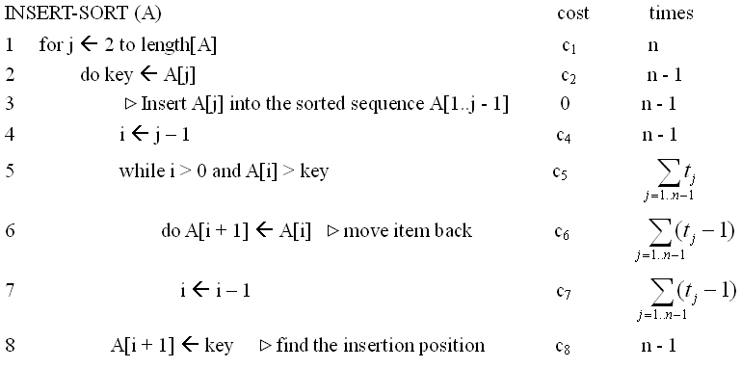
Running time analysis of Insertsort
Sorting Problem:
cost times
c₁
n
c₂
n-1
0
n-1
c₄
n-1
c₅
c₆
c₇
c₈
n-1
t_{j} : the number of times the while loop test in line 5 is executed for the j value.
Note: When a for or while loop exits in the usual way (i.e., due to the test in the loop header), the test is executed one time more than the loop body.

Slide 26
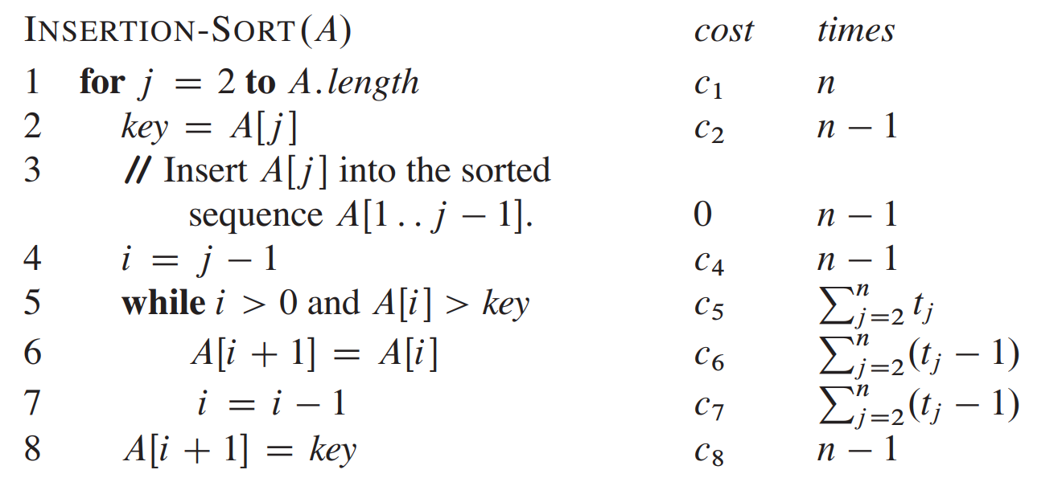
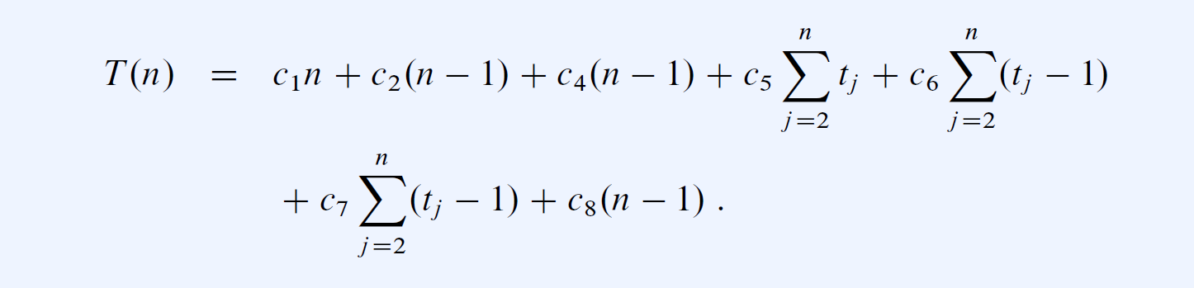
Running time analysis of Insertsort
Input size
Running time
t_{j}: the number of times the while loop test is executed for that value of j

Slide 27
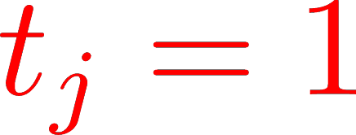
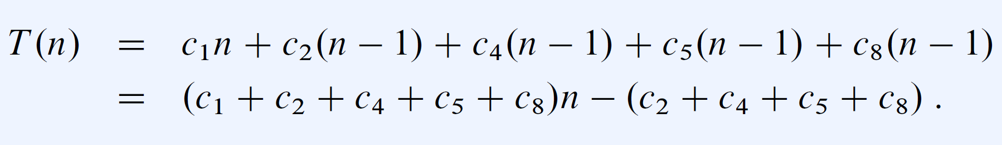


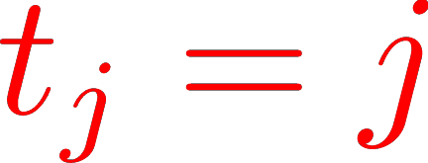
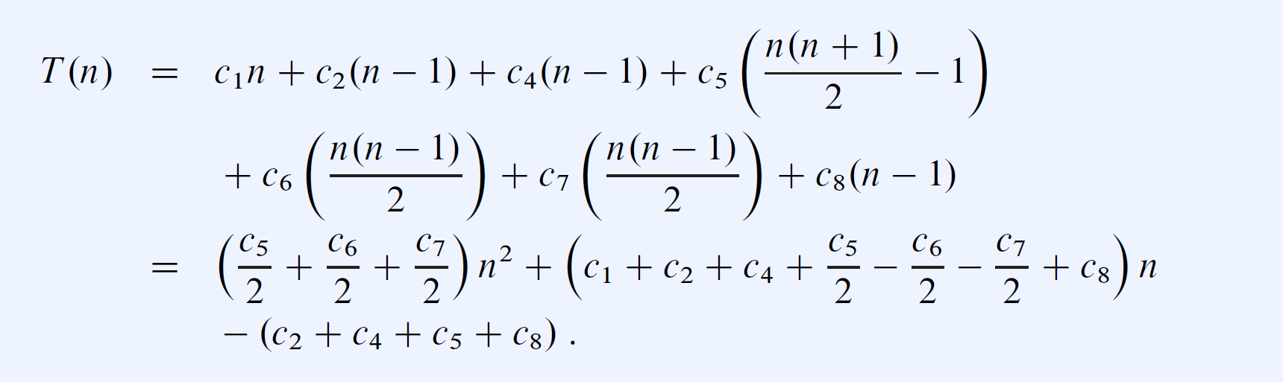

Running time analysis of Insertsort
The best-case running time：a linear function of n.
The worst-case running time：a quadratic function of n.

Slide 28
Worst-case analysis
Worst-case running time. the longest running time for any input of size n.
Running time guarantee for any input of size n.
The worst-case running time of an algorithm gives us an upper bound on the running time for any input.
For some algorithms, the worst case occurs fairly often.
The “average case” is often roughly as bad as the worst case. Generally captures efficiency in practice.
Also. Average-case analysis, probabilistic analysis, amortized analysis, smoothed analysis, and competitive analysis, ...

Slide 29
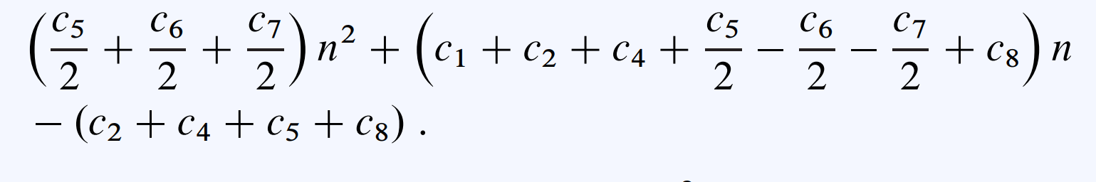

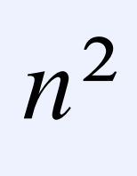
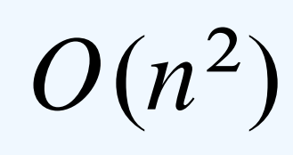
Order of growth
Ignore the actual cost of each statement by abstract cost c_{i}
Ignore the abstract cost c_{i}
Ignore the lower-order terms
Ignore the leading term’s constant coefficient

